Slide 1
PowerPoint Presentation on Heart Disease
By Emmanuel Vidal in fulfillment of DSC 530 requirements

Slide 2
Statistical Question
What are the predictors of heart diseases in the emergency room

Slide 3
Variables in the data set
Age
Sex
0 = Female
1 = Male
CP (Chest Pain Type) (4 types)
No Chest Pain
Mild (Slight limitation on ordinary activity) with strenuous exercise
Moderate (Marked limitation on ordinary activity). Moderate exercise causes chest pain
Severe
Resting blood pressure on admission to the hospital (trestbps)
Serum Cholesterol levels (CHOL)mg/dl

Slide 4
Variables in Dataset CONTD
Fasting Blood Sugar (FBS)>120mg/dl
0=False
1=True
Resting Electrocardiographic results (restECG)
0 = Normal
1 = Non-specific Repolarization Disturbance/LBBB/PM
2 = Significant ST-deviation
Maximum Heartrate achieved (thalach)
Exercise induced Angina (exang)
1=Yes
0=No

Slide 5
Variables in Dataset CONTD
Oldpeak (ST depression induced by exercise relative to rest)
Slope (slope of the peak exercise ST segment)
Number of major vessels (0-3) colored by fluoroscopy (CA)
0 = No Major blood vessels affected
1 =One Major Blood Vessels Affected
2 = Two Major Blood Vessels Affected
3 = Three Major Blood Vessels Affected
Thal
0=Normal
1=Fixed defect
2=Reversable defect
Target
0=No Heart Disease
1= Heart Disease

Slide 6
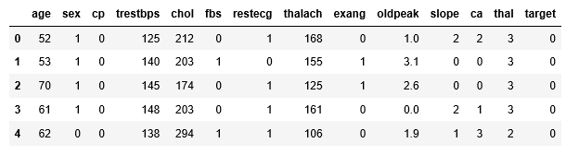
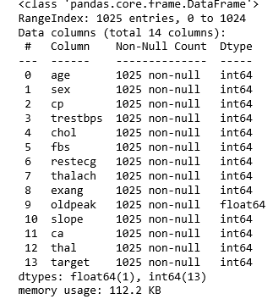
Summary and Analysis

Slide 7
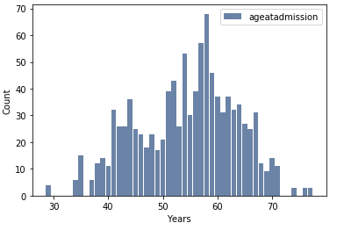
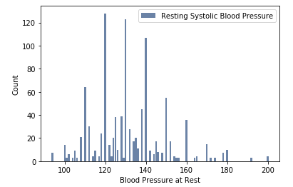
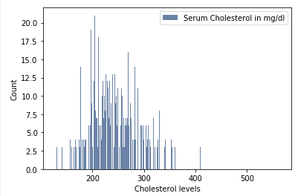
Histogram
Histogram of Age Histogram of B.P Histogram of Chol

Slide 8
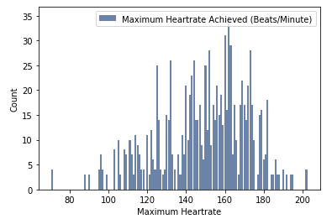
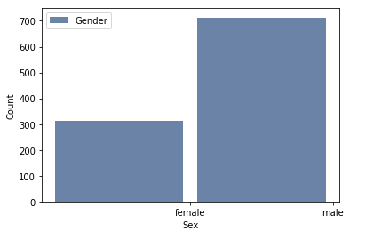
Histogram
Maximum Heartrate SEX

Slide 9
There are a few outliers in the
Age
Cholesterol levels
Blood pressure
Maximum heart rates on both the tails
They are outliers because they are at the extreme end of the values and are not with the other values
Since the outliers are of normal values they would be left alone
No empty observation

Slide 10
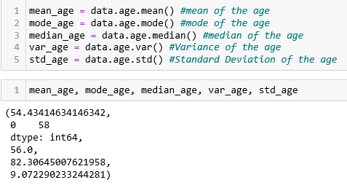
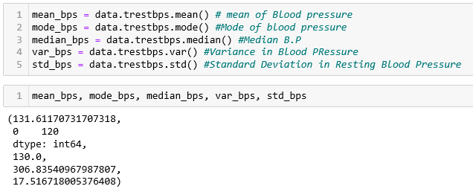
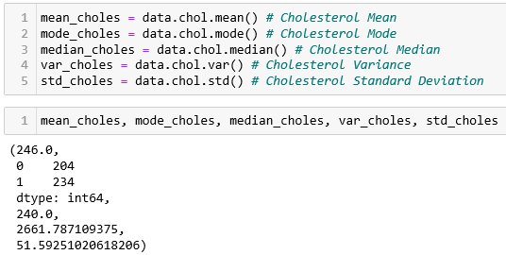
Other Descriptive Characteristics
Age B.P Chol

Slide 11
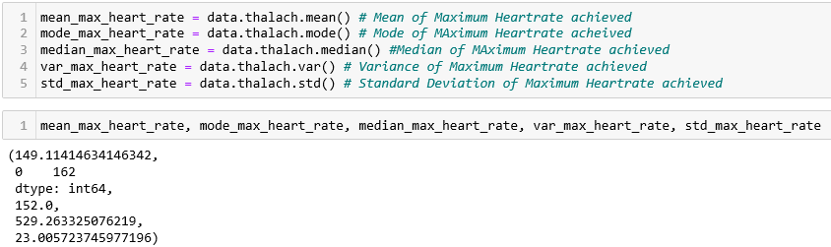
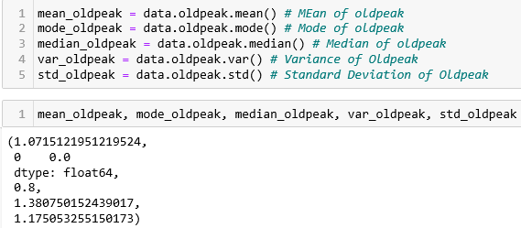
Descriptive Characteristics CONTD
Heartrate Oldpeak

Slide 12
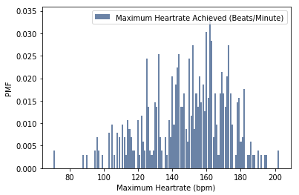
PMF

Slide 13
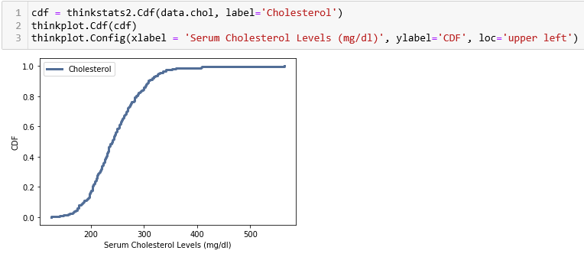
1 CDF with one of the variables
The CDF below shows that 20% of patients had a cholesterol levels less than 210mg/dl
80% of patients had a cholesterol level that is less than 280mg/dl
90% of patients have a cholesterol level less than 320mg/dl

Slide 14
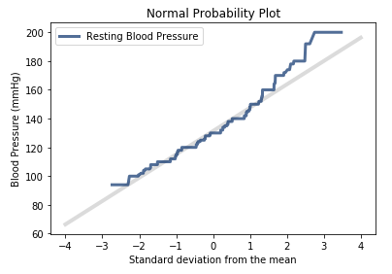
Analytical distribution plot
Normal Probability Plot was Constructed
The plot below suggest that the normal model describes the distribution well within a few standard deviations from the mean. This is good enough for the purpose intended

Slide 15
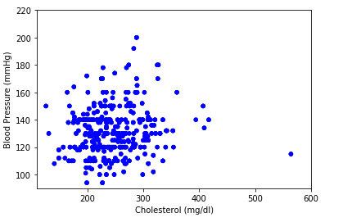
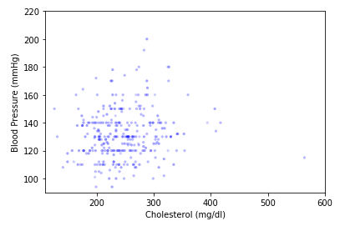
Create 2 Scatter Plot

Slide 16

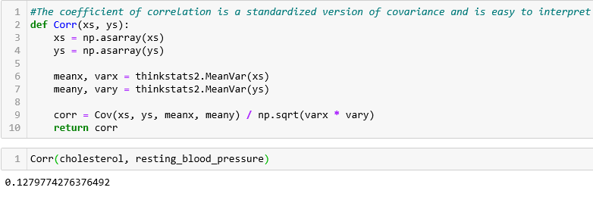
Analysis on Correlation and Causality
Covariance The Coefficient of Correlation

Slide 17
Explanation of the Analysis on Correlation and Causality
The pearson correlation is near zero, while it is tempting to conclude that there is no relationship between the variables, it is not true
The Covariance is positive showing there is a linear relationship between the variables

Slide 18
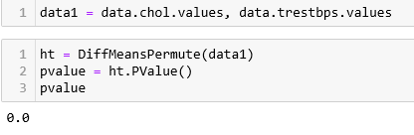
Hypothesis Testing
Permutation test

Slide 19
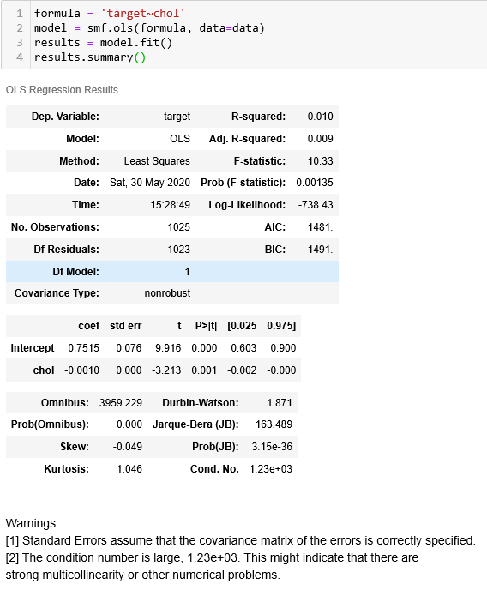
Regression Analysis
One dependent and one explanatory

Slide 20
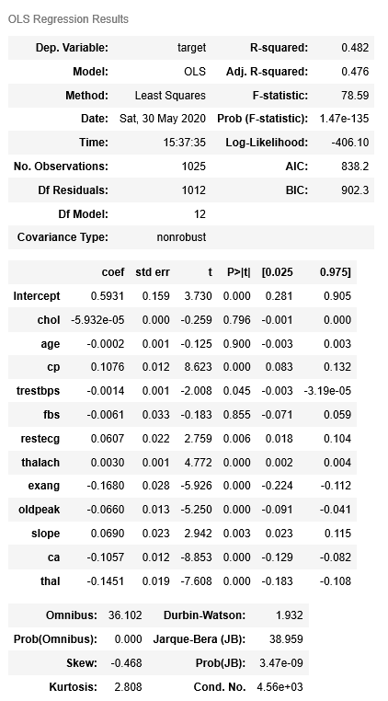
Regression Analysis CONTD
One Dependent and multiple explanatory variables

